Slide 1
Digital Technology
Development Phase

Slide 2
So far…The Design Phase
Understand the company/brand
Understand the purpose of the website
Understand the audience
Design
Look and feel
User journey/flow
Mockup

Slide 3
Now…
Finalize your Design (D3)
Learning to Code
Web Programming Foundations (P2: LI Learning)
Individual Project
Le Wagon Intro to Web Development
HTML: Structure & Content
CSS: Design

Slide 4
Where Are You??
Finalize your Design (D3)
Learning to Code
Web Programming Foundations (P2: LI Learning)
Individual Project
Le Wagon Intro to Web Development
HTML: Structure & Content
CSS: Design

Slide 5
Today
Review some concepts that might not be clear
Explain the next steps beyond the LW module
Directory Structure (and why it matters)
Having more than one page on your site
Developing your CSS files

Slide 6
Directory Structure & Paths
leMonde.fr
css
style.css
buttons.css
images
saleBanner.jpg
owner.jpg
product1.jpg
product2.jpg
cards.css
contactUs.htm
products.htm
index.htm
The root
(of your repository)
Relative path – from current directory
Absolute path – full path

Slide 7
Directory Structure & Paths
leMonde.fr
css
style.css
buttons.css
images
saleBanner.jpg
owner.jpg
product1.jpg
product2.jpg
cards.css
contactUs.htm
products.htm
index.htm
The root
(of your repository)
Absolute Path: http://leMonde.fr/contactUs.htm
Relative Path (from the index.htm file): contactUs.htm

Slide 8
Directory Structure & Paths
leMonde.fr
css
style.css
buttons.css
images
saleBanner.jpg
owner.jpg
product1.jpg
product2.jpg
cards.css
contactUs.htm
products.htm
index.htm
The root
(of your repository)
Absolute Path: http://leMonde.fr/images/saleBanner.jpg
Relative Path (from the index.htm file): /images/saleBanner.jpg

Slide 9
Directory Structure & Paths
leMonde.fr
css
style.css
buttons.css
images
saleBanner.jpg
owner.jpg
product1.jpg
product2.jpg
cards.css
contactUs.htm
products.htm
index.htm
The root
(of your repository)
Absolute Path: leMonde.fr/images/saleBanner.jpg
Relative Path (from the index.htm file): /images/saleBanner.jpg

Slide 10
Directory Structure & Paths
leMonde.fr
css
style.css
buttons.css
images
saleBanner.jpg
owner.jpg
product1.jpg
product2.jpg
cards.css
contactUs.htm
products.htm
index.htm
The root
(of your repository)
Absolute Path: http://leMonde.fr/images/saleBanner.jpg
Relative Path (from the index.htm file): ../images/saleBanner.jpg

Slide 11
Directory Structure & Paths
leMonde.fr
styles
style.css
forms
images
saleBanner.jpg
employees
product1.jpg
product2.jpg
cards.css
contactUs.htm
products
index.htm
products
joe.jpg
jill.jpg
buttons.css
inputs.css
dresses
shoes
gowns.htm
leasure.htm
heels.htm
sandals.htm
Directories let us set permissions for who/what can access certain files

Slide 12
Directory Structure & Paths
leMonde.fr
styles
style.css
forms
images
saleBanner.jpg
employees
product1.jpg
product2.jpg
cards.css
contactUs.htm
products
index.htm
products
joe.jpg
jill.jpg
buttons.css
inputs.css
dresses
shoes
gowns.htm
leasure.htm
heels.htm
sandals.htm
scripts
Directories let us set permissions for who/what can access certain files

Slide 13
Filenames and paths matter!!
Homepage must be named index.htm
index.htm must be at the root of the directory structure
If it’s inside a subdirectory, it won’t be found and you’ll get a 404 file not found error!

Slide 14
Filenames and paths matter!!
If your images aren’t displaying, check the path and name!
On many (most) systems, the names are case sensitive, so the CSS directory is different from the css directory.

Slide 15
Filenames and paths matter!!
Get used to using certain naming conventions:
camel case: myFileNameHasHumps.js
underscores: my_file_name_has_underscores.htm
dashes: my-file-name-has-dashes.htm
NEVER HAVE SPACES IN NAMES!!!

Slide 16
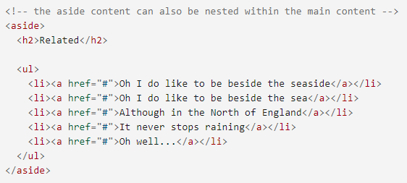
Make your code easy to read and understand!!
Use comment to explain and break up code
Use whitespace (blank lines) to break up code
Use whitespace (tab/indent) for nested elements

Slide 17

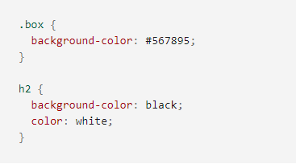
Make your code easy to read and understand!!
Use comment to explain and break up code
Use whitespace (blank lines) to break up code
Indent nested elements
Break up long style sheets into multiple sheets

Slide 18
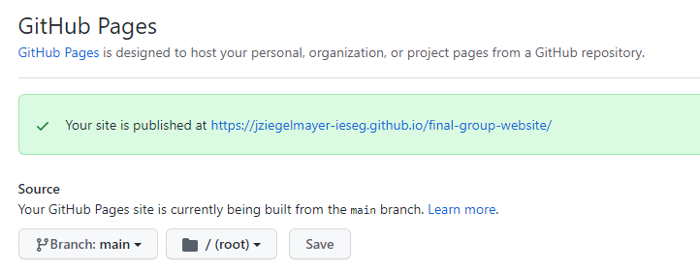
Change of location & terminology
GitHub Pages is on a separate page
master/slave no longer used by github
Set your source to main branch (not master)

Slide 19
Questions?
If no overall questions, you can continue working on:
Deliverable 3 of Team Project
Participation 2
Individual Project (Le Wagon module)
I’ll come around to help people with questions or problems.

